Slide 1


SAP UI5 & FIORI with OData TRAINING
Anubhav Oberoy & Nishan Nainsukha
Day – 9

Slide 2

Agenda
Element Binding
Use Case for the Element Binding
Model Related Examples
Flip Model Button (Example 1)
Delete Button (Example 2)

Slide 3
Element Binding
Element binding allows to bind elements to a specific object in the model data, which will create a binding context and allow relative binding within the control and all of its children. This is especially helpful in master/detail scenarios.
Binding an element allows to set the binding context of the element to the object referenced by the given binding path. Thus, all relative bindings within the control and all of its children are resolved relative to this object. For server-side models, the element binding triggers the request to the server to load the referenced object in case it is not yet available on the client.
Element bindings can also be defined relatively. In case of relative element bindings, the binding context is updated when the parent binding context is changed.
Element binding is useful for containers and layouts containing other controls. All these child controls would be required to use properties of the same model object or model node, then element-binding is preferable.
An element to be bound to an object in the Model can be achieved by Element binding.
To define an element binding, use the bindElement method on a control:
oControl.bindElement(“/company”);
oControl.bindProperty(“value”, “name”);

Slide 4
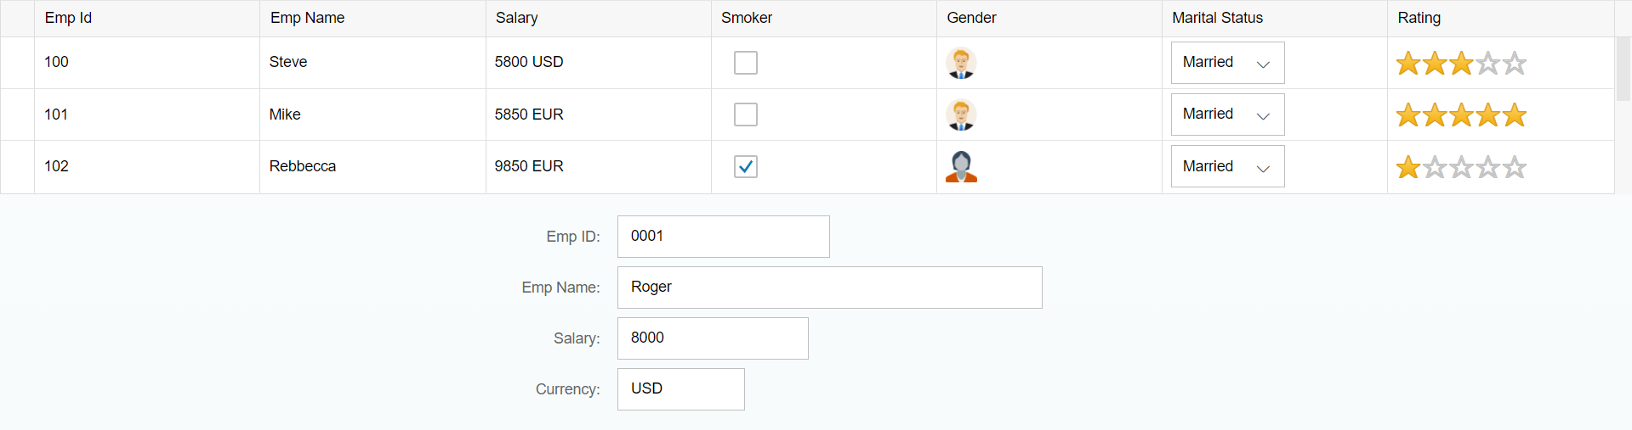
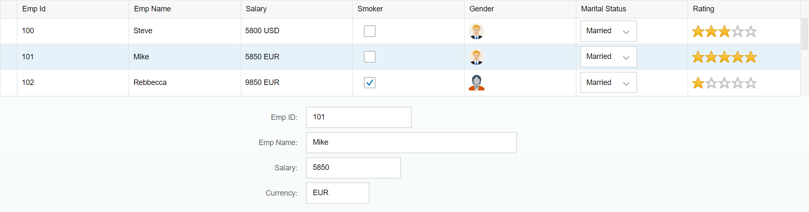
Example of Element binding
We have a use case here, when we select a row in the table then the data related to that row is visible in the form.
After selecting the row
Flow for this example:-
Table
/empTab/0
/empTab/1
/empTab/2
Emp Id | Emp Name | Salary
{empId} | {empName} | {salary}
Element 0
Element 1
Simple Form
Element 2
Field 0
/empTab/0 /empId
Field 1
/empTab/0/empName
All the content of Row 1 in the table is bind to all the fields in the form
/empTab/0 /salary
Field 2

Slide 5

Exercise 1
In this exercise we will see the example of Element Binding.
On selection of a row in the table the data in the row should show in the form.
Exercise Code:-
MyXML.view.xml
MyXML.controller.js

Slide 6
Playing with Models
Example 1:- Flip Model
Now, we will see a few more examples related to the models.
So we have a use case here, we want a button on the UI, on press of that button, the model bind with the table will be flipped with another model.
Flow to Flip the model:-
Set as default model
View
The View is always bind to the default model.
Load Data
Sample.json
oModel
sap.ui.getCore().setModel(oModel);
sap.ui.getCore().setModel(oModelGot);
on Button Press
sap.ui.getCore().setModel(oModel, “got”);
Load Data
When the flip model button is pressed the then oModel is set to Named model “got” and oModelGot is set as default.
data.json
oModelGot
sap.ui.getCore().setModel(oModelGot, “got”);
Flip Model
Set as named model “got”

Slide 7

Exercise 2
In this exercise we will perform the example which we have discussed in previous slide.
We will add a button to flip the model
Exercise code:-
MyXML.view.xml
MyXML.controller.js

Slide 8
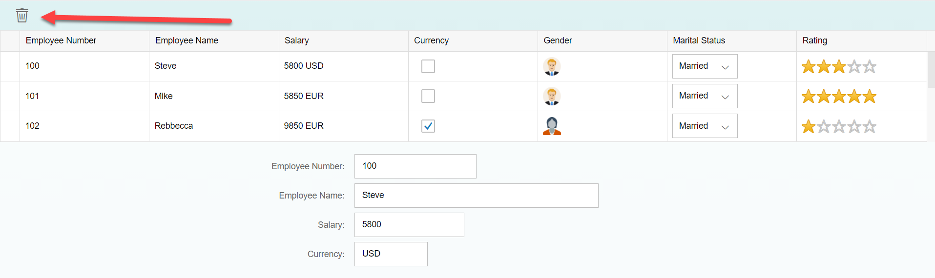
Playing with Models continue…
Example 2:- Delete Row
Now, we will add Delete button on top of the Table, on press of the Delete button the selected row will be deleted form the table and if No row is selected a Message Toast will be shown to select a row.
Flow to perform this task:-
Select a Row
On Selecting a row in the table
Save index value to a global variable
Access the value of index global variable
If it is undefine then show Message Toast
on Press of Delete Button
Yes
Check if the variable is equal to undefined
Set the global variable to undefined
Remove the index from the default model
No

Slide 9

Exercise 3
Now we will perform the Delete row task discussed in Previous Slide
Exercise Code:-
MyXML.view.xml
MyXML.controller.js

Slide 10

End of Day 9

Slide 11

Any Questions ?

Slide 12

Anubhav Oberoy

Slide 13
Title
Content

